Slide 1
Labelling Cyber Data with the CCO

Slide 2
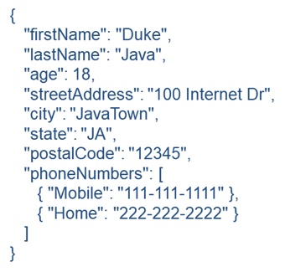
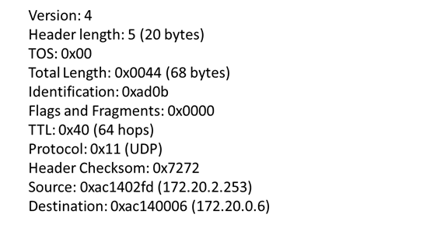
Classifying Entities Represented by Data
Elements of application data are always labelled:
Protocol: IPv4
Source IP Address: 172.20.2.253
and almost always grouped to describe an entity of interest or enable some process
JSON person object IP Datagram Header

Slide 3
Classifying Entities Represented by Data
Labelling and grouping of data is often inadequate to classify composed entities of interest
Is this packet transfer part of a denial-of-service attack?
Is this build up of armored-vehicles part of an invasion?
Does this blood pressure reading signify heart disease?

Slide 4
Classifying Entities Represented by Data
The standard means to support inferencing in ontologies - creating a definition of necessary and sufficient conditions falls short of the need here
Data may always be incomplete so the inference may never be made
Adequate evidence for the inference may come too late for response

Slide 5
Sensemaking and Process Specifications
Sensemaking is a process in which subject matter experts come to situational awareness from incomplete evidence utilizing the construct of a process specification* (a.k.a. expertise schema, pattern of life)
A process specification is an information entity that is encoded in a SME’s understanding of the way an event typically unfolds
The representation of the typical event includes observable entities known as indicators and can include entities that are correlated to but are not part of the event.
The values of indicators as described by the process specification are the link to data
*Pirolli, Peter, and Stuart Card. "The sensemaking process and leverage points for analyst technology as identified through cognitive task analysis." Proceedings of international conference on intelligence analysis. Vol. 5. 2005.

Slide 6
Constraints and Requirements of Modeling Process Specifications
BFO (realism) and OWL
Described with as much detail as actual entities
Easily distinguishable from actual entities
Easily comparable with actual entities
Implementation neutral

Slide 7
Representation of Modal Entities
Modal Relation Ontology
A set of object properties (relations) that are a one-to-one match to those in BFO and CCO
Different namespace
http://www.ontologyrepository.com/CommonCoreOntologies/Mid/ModalRelationOntology
Instances linked together using only modal relations signifies that the referent of the statement does not exist

Slide 8
Example: Port Scan - The Encapsulation Process
Port Scanner
agent in
Computer Program Execution
has output
Digital File
is input of
Data Encapsulation Process
has output
Transmission Control Protocol PDU (a.k.a. Segment)
is input of
Data Encapsulation Process
has output
Internet Protocol PDU (a.k.a. Datagram)
is input of
Data Encapsulation Process
has output
Data Link Layer PDU (a.k.a. Frame)

Slide 9
Example Port Scan - The TCP/IP Information Stack
has part
Frame Header
has part
Destination MAC Address
Source MAC Address
Ether Type
Data
Frame Check Sequence
Data Link Layer PDU (a.k.a. Frame)
Frame Trailer
has part
Version
HLEN
Type of Service
Identification
IP Flags (3) RESERVED, DO NOT FRAGMENT, MORE FRAGMENTS
Fragment Offset
Time to Live
Protocol
Header Checksum
Source IP
Destination IP
Option
Data
has part
Internet Protocol PDU (a.k.a. Datagram)
has part
Datagram Header
has part
has part
has part
Source Port
Destination Port
Sequence Number
Acknowledgment Number
Data Offset
Reserved
TCP Flags (9) NS, CWR, ECE, URG, ACK, PSH, RST, SYN=1, FIN
Window Size
Checksum
Urgent Pointer
Options
Transmission Control Protocol PDU (a.k.a. Segment)
Segment Header
has part
Elements used in detection are Source IP, Destination IP and Destination Port

Slide 10
Example: Port Scan - The SYN Packet Transfers
Contains the SYN Packet
Network Source
The Encapsulation Process
Data Link Layer PDU (a.k.a. Frame)
Network Destination
The Encapsulation Process
has output
Data Link Layer PDU (a.k.a. Frame)
participates
in
participates
in
has role
has role
Network Host
sends
Packet Transfer
receives
Network Host
Packet Transfer
has part
Port Number
designated
by
Computer Networking Port

Slide 11
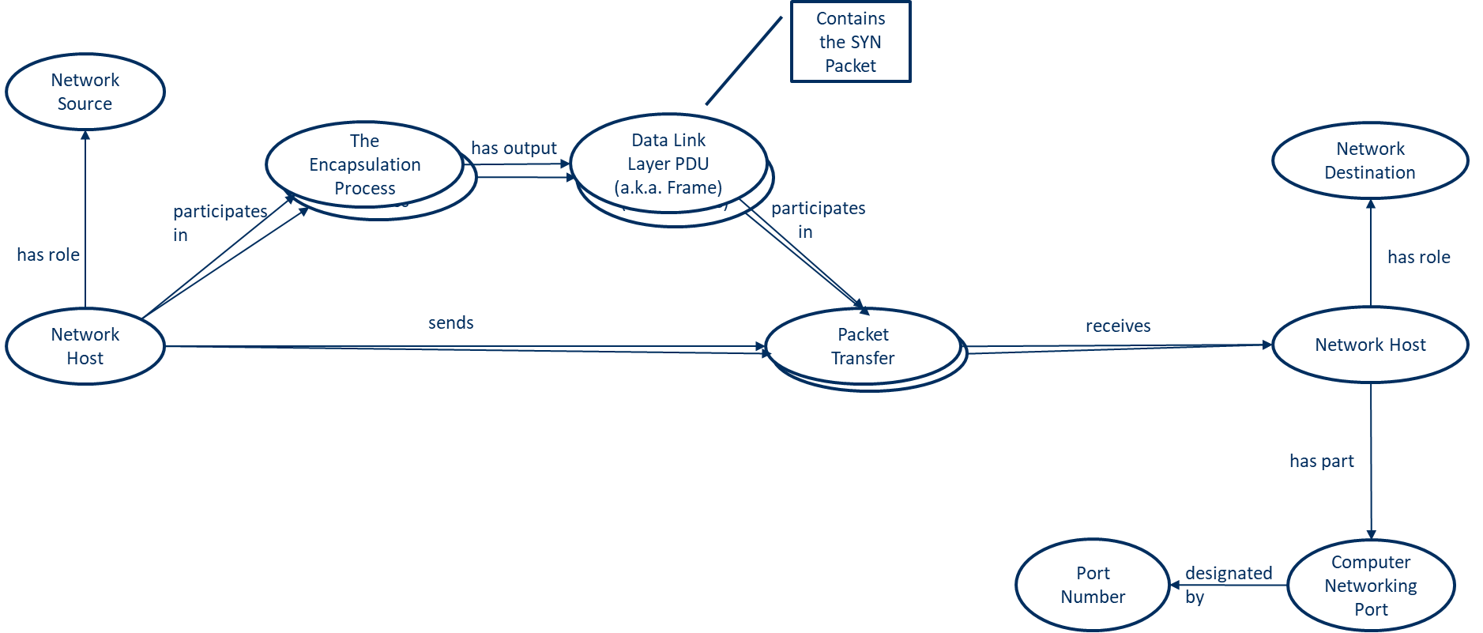
The Port Scan Process Specification
false
has value
true
has value
true
has value
Equivalent Value Measure
Equivalent Value Measure
Equivalent Value Measure
Port Scan Process Specification
describes
describes
describes
describes
Aggregate of Segment Header Destination Port Fields
Aggregate of Datagram Header Destination IP Fields
Aggregate of Datagram Header Source IP Fields
Port Scan Attack
occurs on
has part
Port Scan Attack Duration
is a
measurement of
has process part
has value
Number SYN Packet Transfers
SYN Packets
participates
in
Packet Transfers
Min 2
has ending instant
has starting instant
has part
has process part
Port Scan Attack Start Time
Port Scan Attack End Time
designates
designates
Port Scan Attack Start Time Identifier
Port Scan Attack End Time Identifier
has value
has value
2021-04-13T09:30.10.5
2021-04-13T09:32.10.5

Slide 12
Miscellany on the Current State of Practice
Specializations of process specifications made by the inclusion of an actor and any signature variations made in the performance of the event
Weights can be associated to indicators and used to calculate a measure of confidence in the occurrence of the event
Different SMEs may create distinct process specifications for the same event

Slide 13
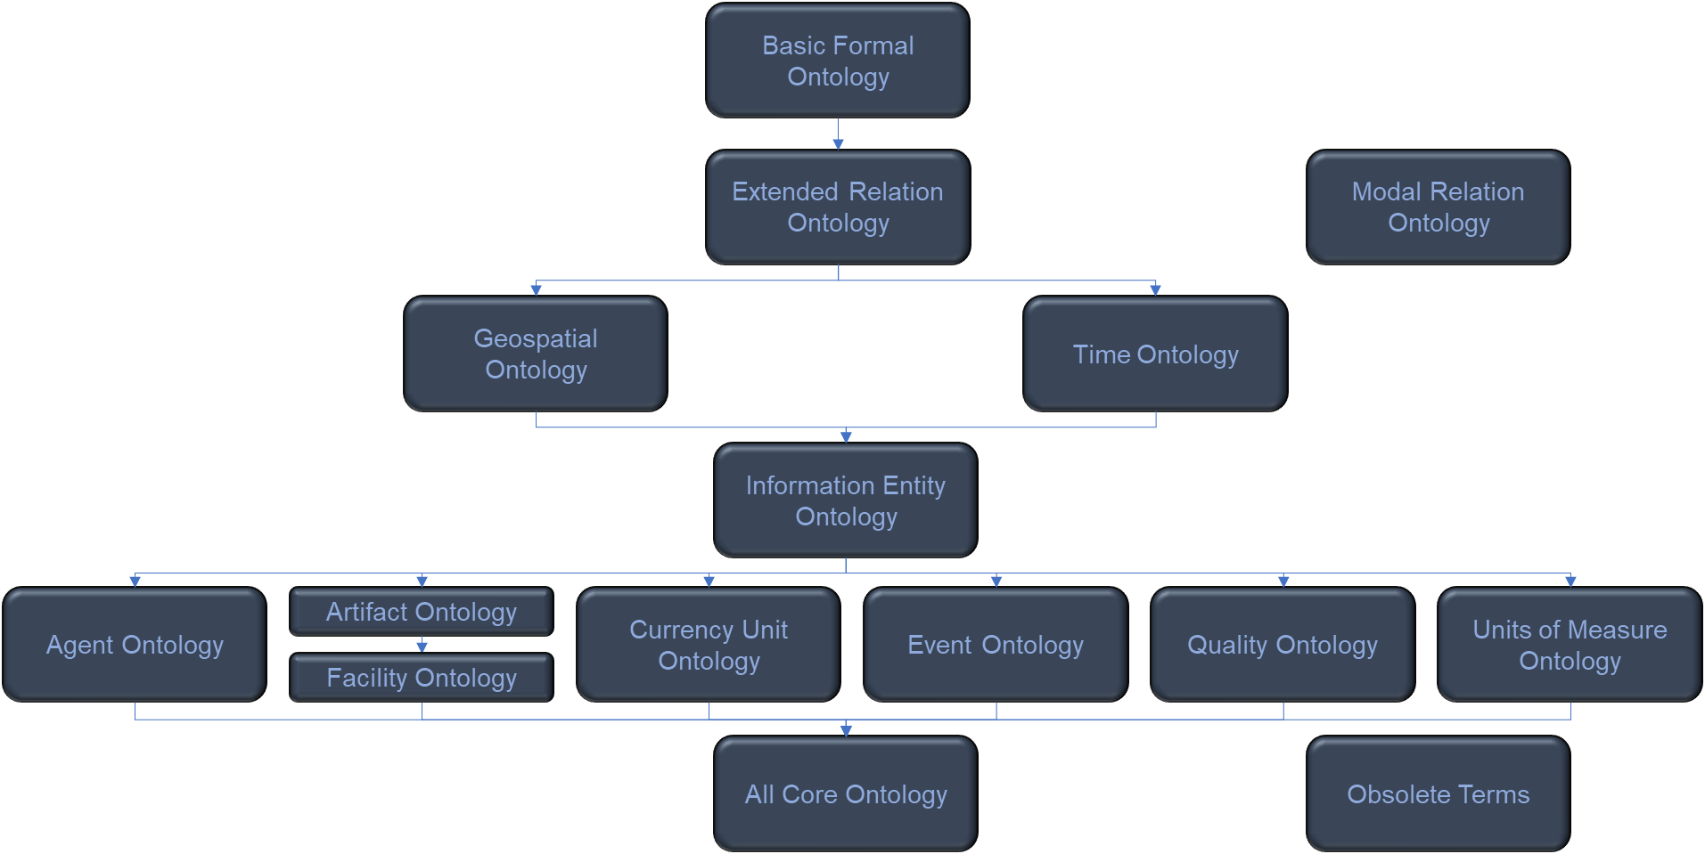
Advantages of a Single Ontological Framework
Models from different sources are more easily merged
Hardware
Mission
Organization
Network

